Slide 1


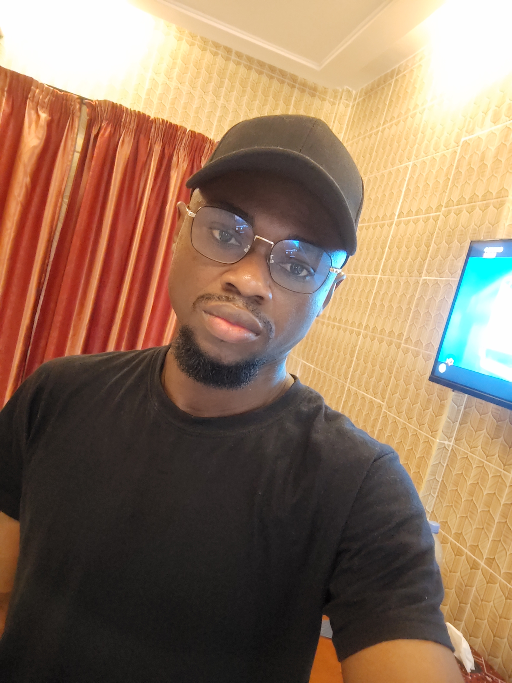
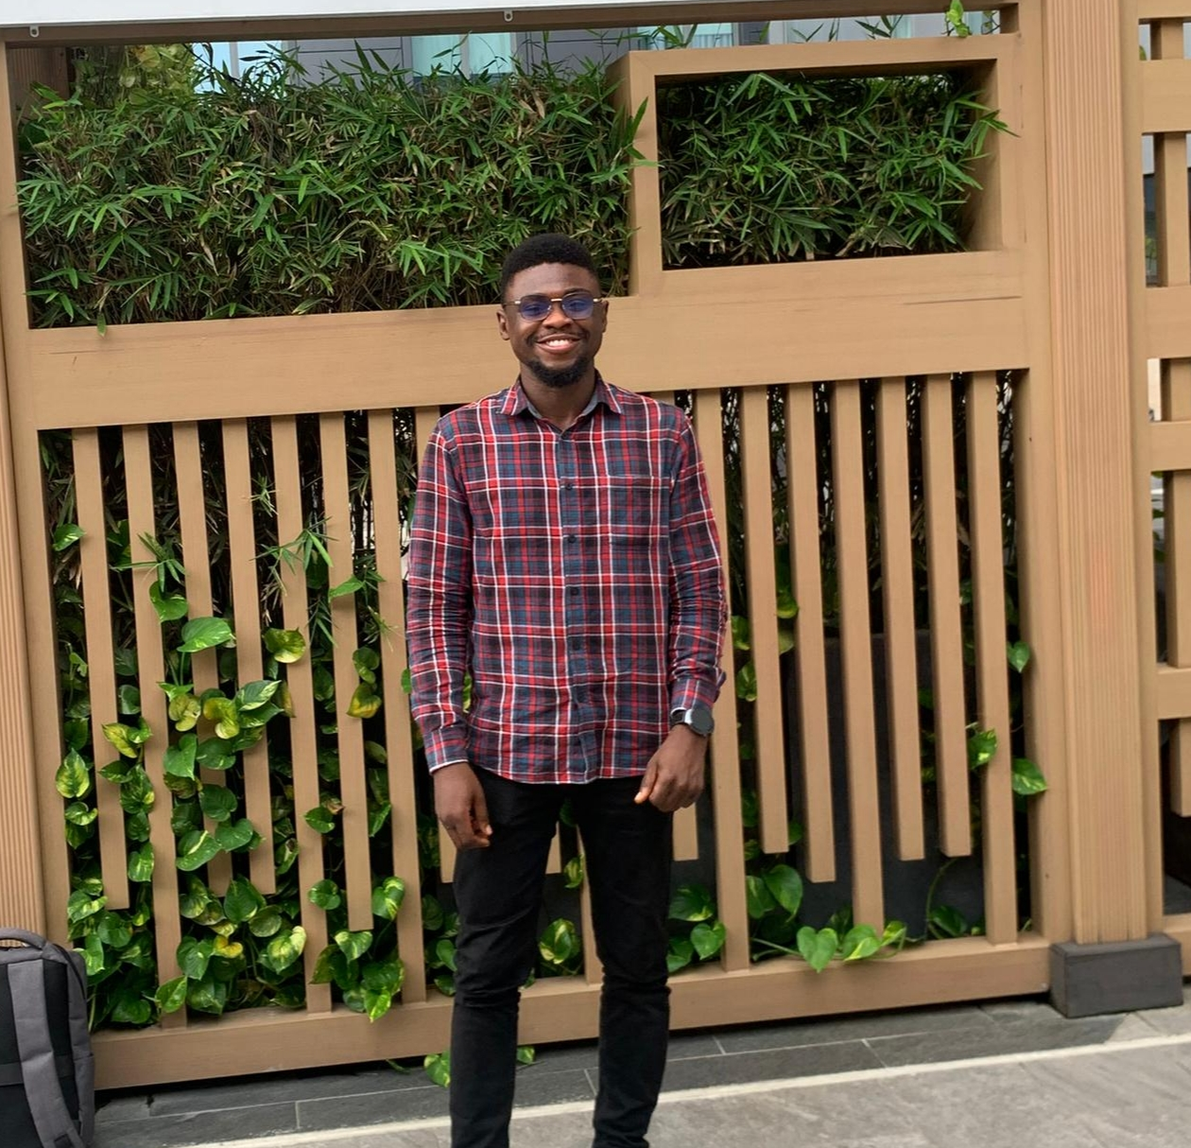
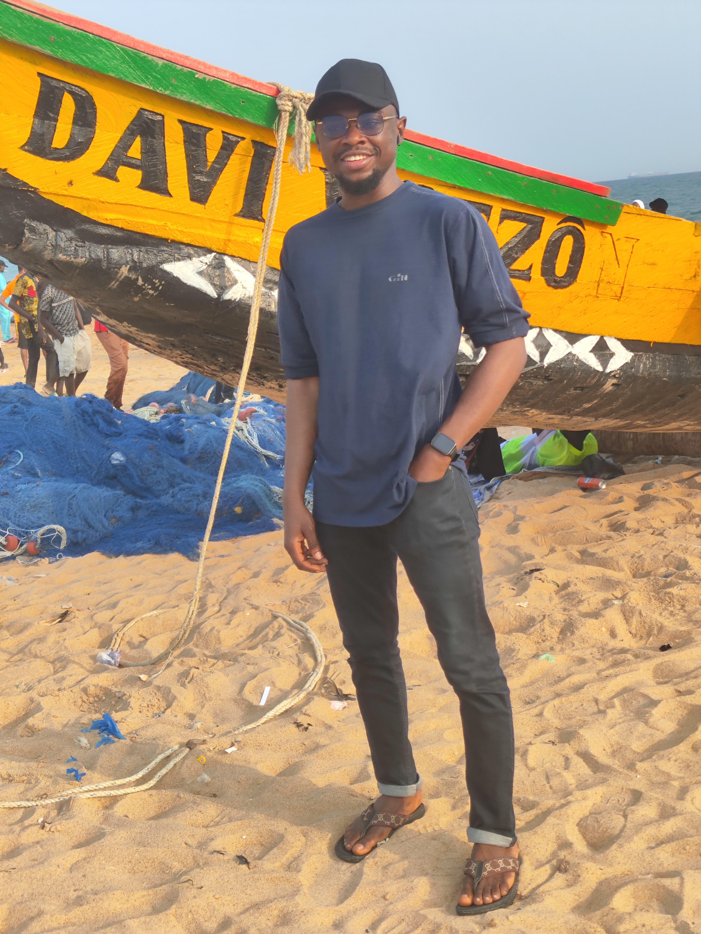
Getting to Know Me
Work
Personal
My role
Quality Control Manager
Significant others / family members / furry friends in my life
My father, mother and siblings
Tenure in ofi/Olam
3 years
How I enjoy spending my free time
Relaxing, exploring new ideas, playing virtual games, and spending quality time with loved ones
Previous companies I have worked at
TCN Nigeria
My favorite / comfort food
Vegetable and pounded yam
Why I joined ofi/Olam and what keeps me here?
Learning, challenges, and a supportive environment
My favorite song
Hand of God – Jon Bellion
Ademola Adebisi
‘Ademola’
A few fun facts about me
I have a knack for turning everyday moments into learning adventures – if curiosity were a sport, I’d probably have a gold medal by now
This is me outside work, doing stuff I enjoy in my life …

